Slide 1
Introduction to Django

Slide 2
What is Django?
Django is a free and open source web app framework
A web framework helps to effectively develop website.
Django follow DRY (Don’t Repeat Yourself)
Supports multiple databases Postgres, MySql and Oracle
Supports Integration with other open source libraries like numpy, pandas as and when required.

Slide 3
Key highlights
Authentication support
Database schema migrations
Object relational mapper(ORM)
Support for web servers
Template engine
Url routing

Slide 4
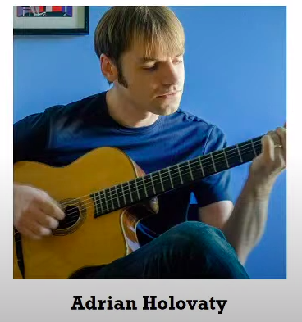
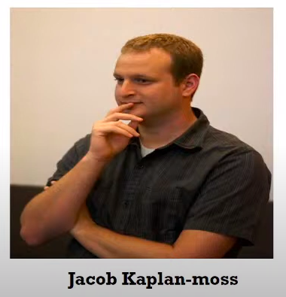
Django Founders

Slide 5
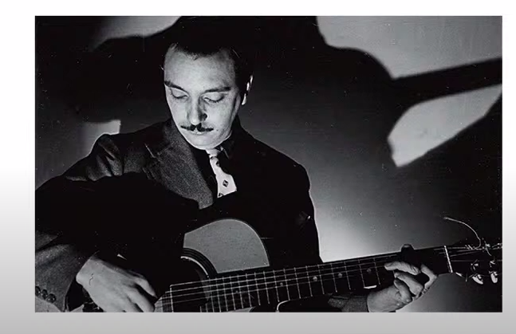
History of Django Name
Was named after famous guitarist “Django Reinhardt”

Slide 6
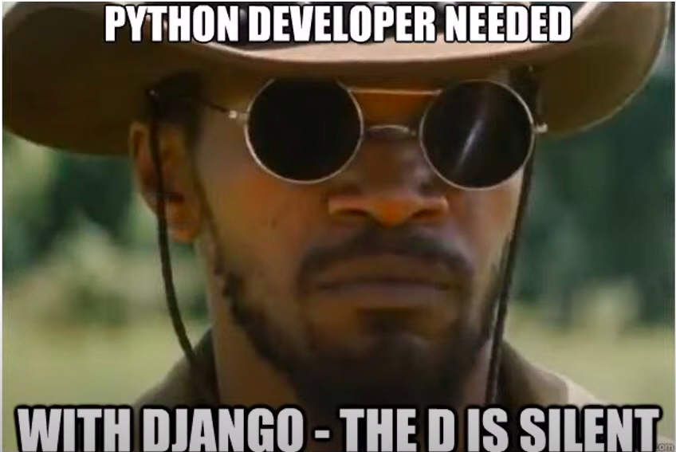
How to say Django?

Slide 7
Version History
Open sourced in 2005
First version released in Sep’08
Current Version :- 3.1.6

Slide 8
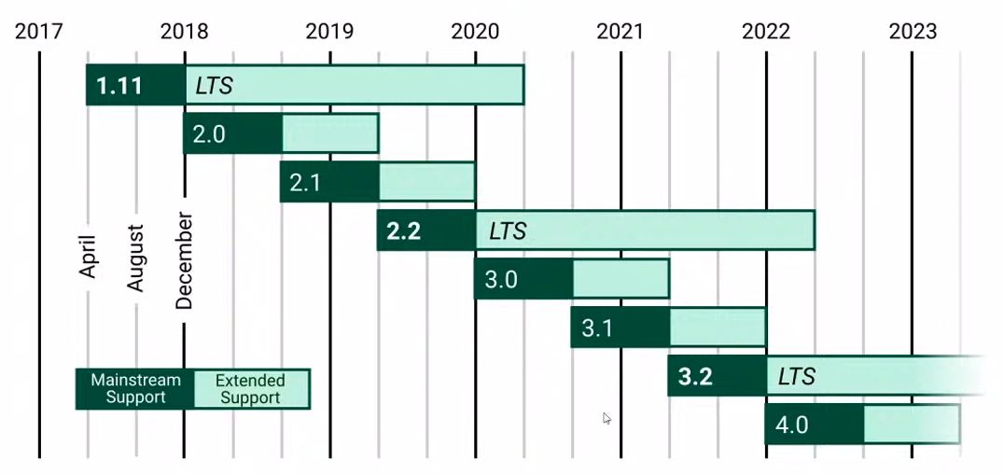
Version Timeline

Slide 9
Features
Fast & Simple
Open source
It’s secure

Slide 10
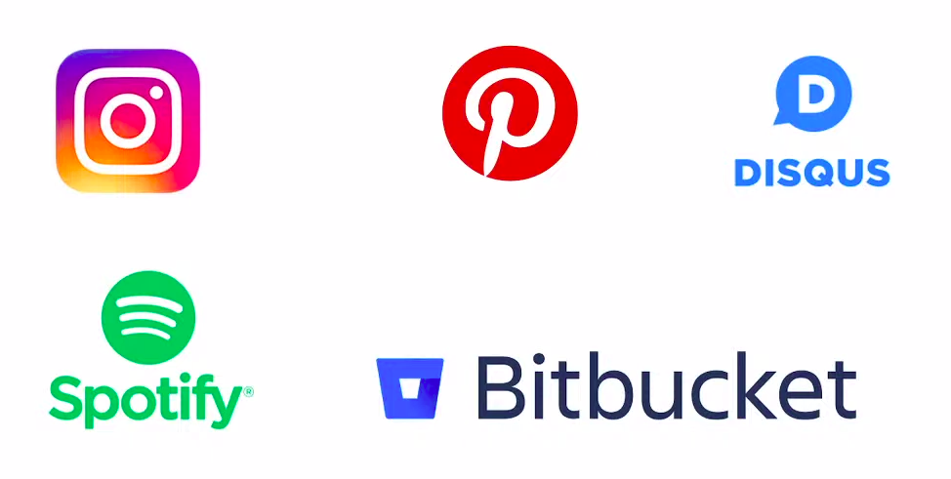
Who is using?

Slide 11
When to use Django?
You need to deploy a web app or api backend
You need to move fast, deploy fast and also make changes as move ahead.
The app must be secure from common vulnerabilies like CSRF, SQL injections, XSS, Clickjacking etc
You might integrated with cutting edge tech in future, eg. Maching Learning

Slide 12
Django MVT
It follows MVT and not MVC
Model
Defines the data structured
Takes care of query the database
View
Defines what should be presented
Returns HTTP Response
Template
Renders the data in suitable format – HTML/XML etc

Slide 13
Prerequisites
The basics syntax of python
Function’s
Module’s
Conditional operators and loops
Object-oriented concepts
Database and SQL queries

Slide 14
Which IDE?
Notepad++
Sublime Text
Atom
Pycharm
Vscode

Slide 15
Installation
Install miniconda
https://docs.conda.io/en/latest/miniconda.html
Virtual environments
Install Python
Install Django

Slide 16
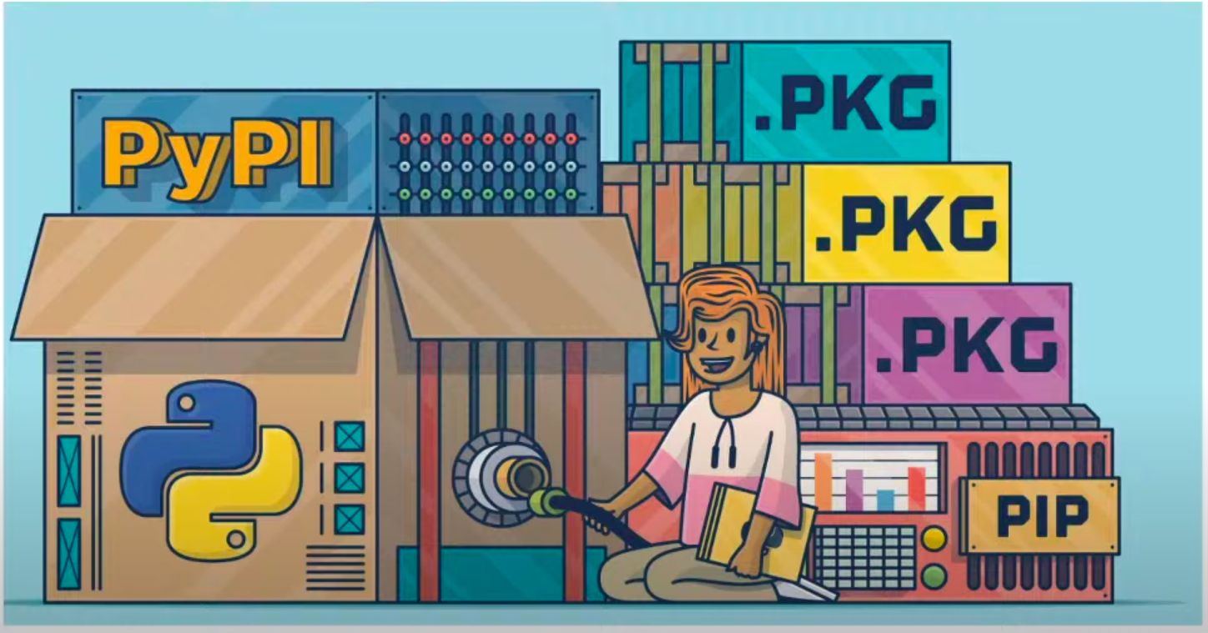
What is PIP?

Slide 17
What is PIP?
Package manager for python
Use to install and upgrade various python packages
Similar to nuget(.net), npm(nodejs),gem(ruby)
Commands
pip help
pip install “package”
pip show “package”
More info on https://pypi.org

Slide 18
Thank You

